Slide 1
Immunology
Immunity
Components of immunity
WBC -Different types and function
Antigen- Factors determining antigenicity
Antibodies- Monoclonal and Polyclonal
Antigen-antibody interaction
Immunoassays
Agglutination – Blood grouping
ELISA

Slide 2
Body Defenses against Infection: Immunity
pathogen (disease causing agents: bacteria, viruses, etc)
innate defenses
general defenses
protects against many pathogens
Immunity
adaptive defenses
immunity
more specific
carried out by
lymphocytes
Innate
Adaptive
(Nonspecific)
(Specific)
Humoral
Cell-mediated
(antibody)
(cells)

Slide 3
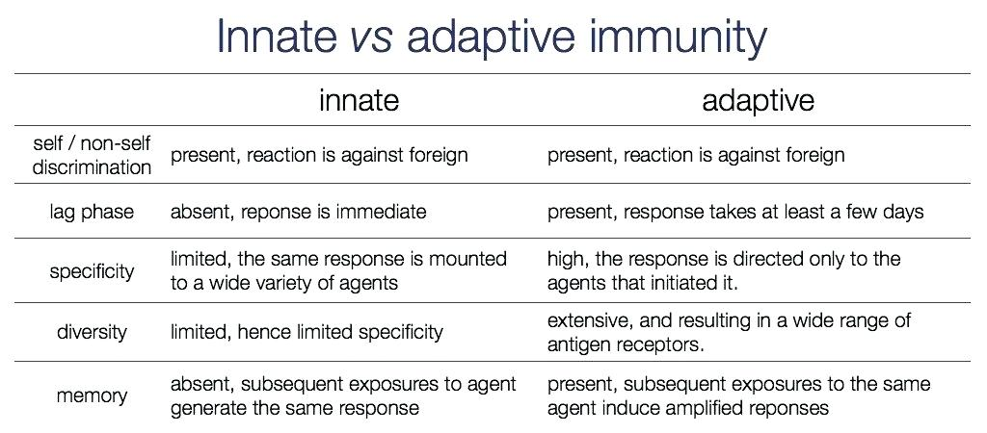

Slide 4
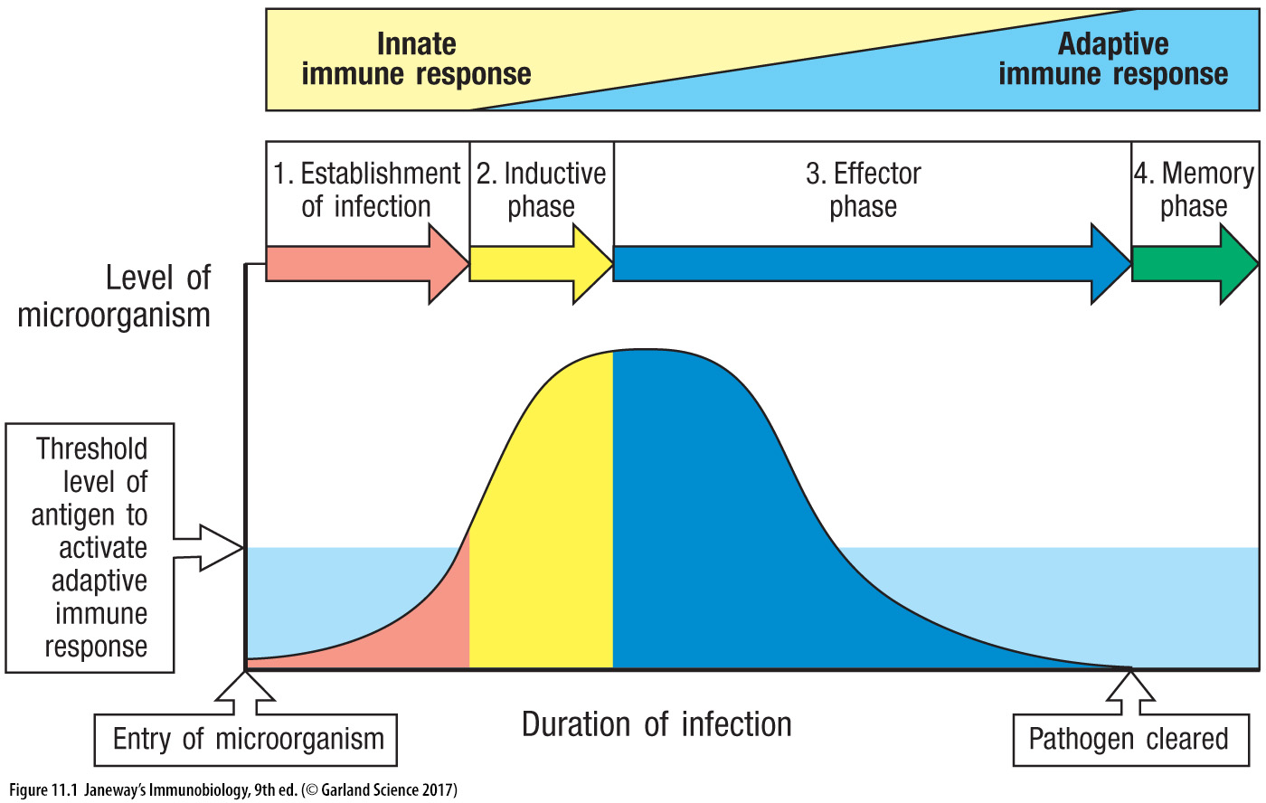

Slide 5
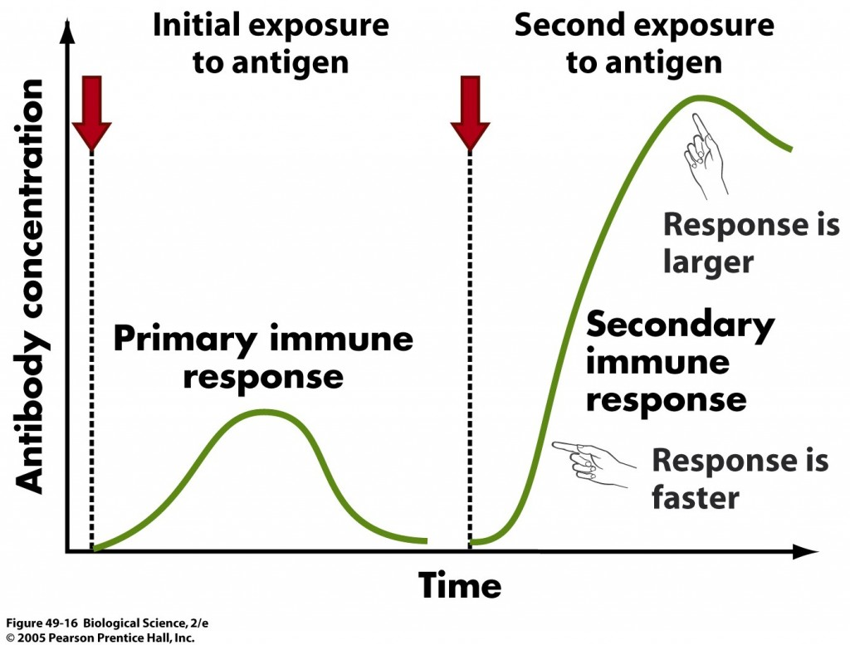
Vaccination and property of memory
https://www.who.int/news-room/feature-stories/detail/how-do-vaccines-work

Slide 6
Function of the Immune System (Self/Non-self Discrimination)
To protect from pathogens
Intracellular (e.g. viruses and some bacteria and parasites)
Extracellular (e.g. most bacteria, fungi and parasites)
To eliminate modified or altered self

Slide 7
Effects of the Immune System
Beneficial:
Protection from Invaders
Elimination of Altered Self
Detrimental:
Discomfort and collateral damage (inflammation)
Damage to self (hypersensitivity or autoimmunity)

Slide 8
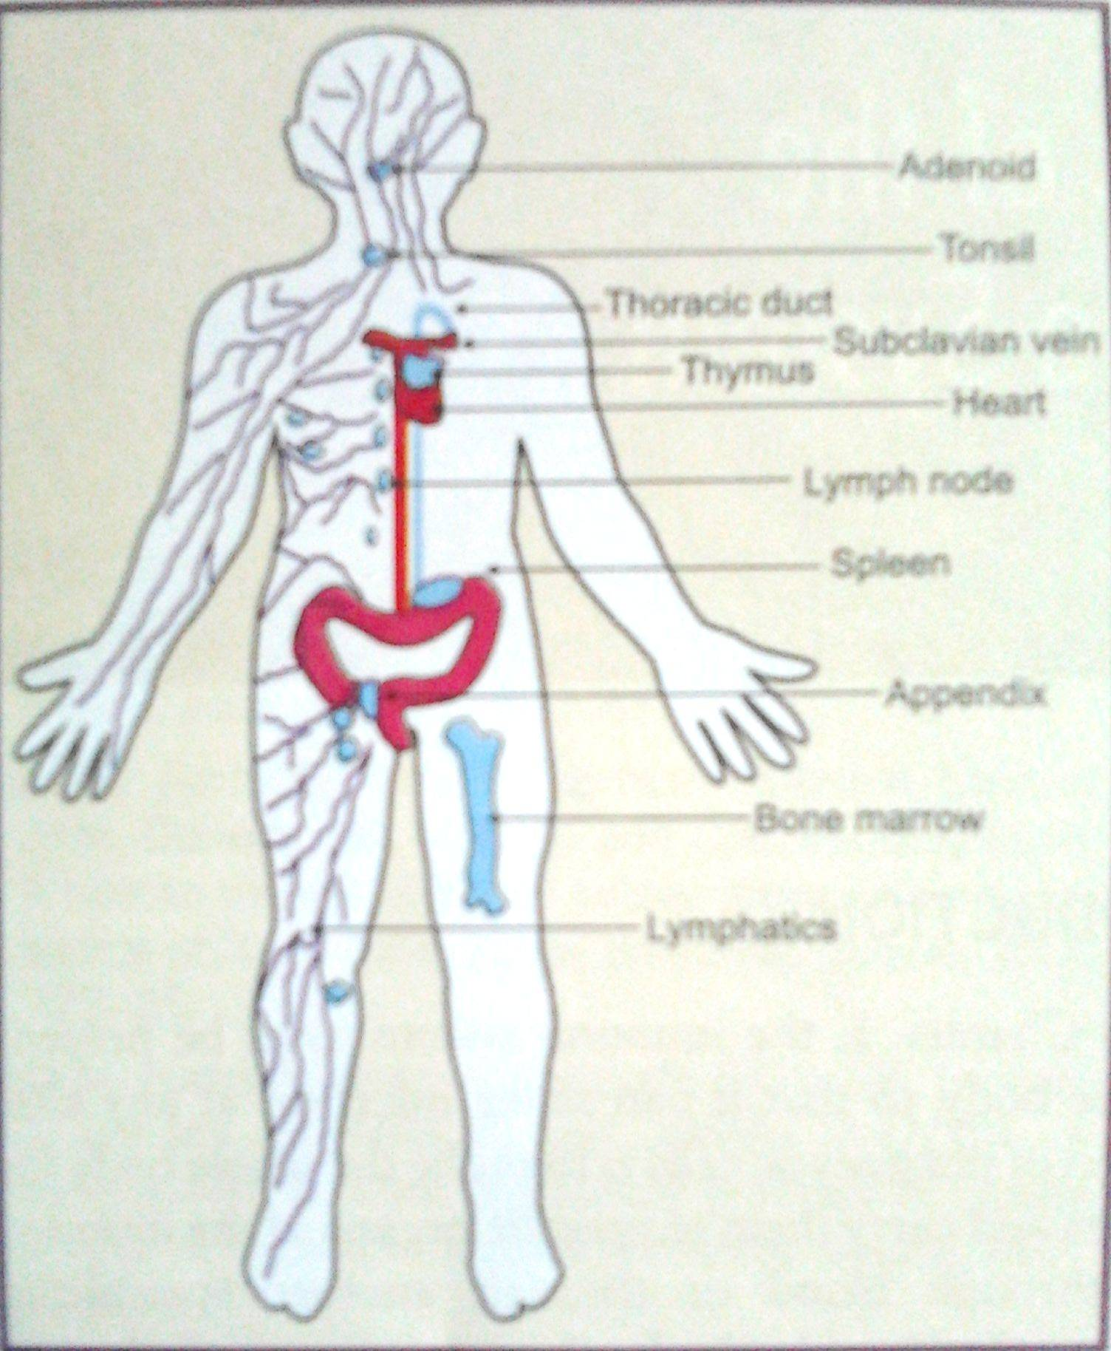
Organs of the Immune system
The lymphoid organs are those organs in which lymphocyte maturation, differentiation, and proliferation take place
The primary (central) lymphoid organs (bone marrow and thymus) are those in which the maturation of T and B lymphocytes into antigen-recognizing lymphocytes occurs
The secondary (peripheral) lymphoid organs (spleen, lymph nodes, gut-associated lymphoid tissue) are those organs in which antigen-driven proliferation and differentiation take place

Slide 9
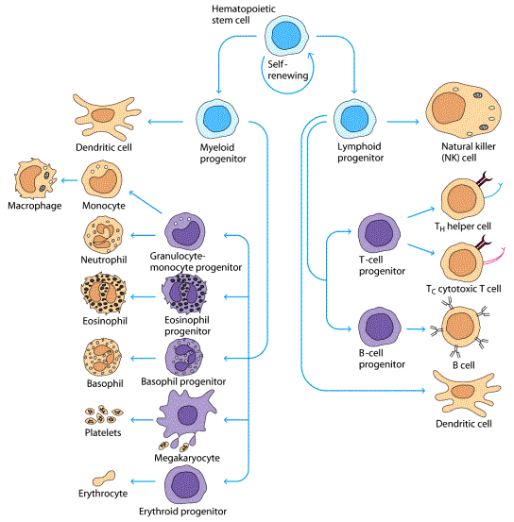
Cells of the Immune System

Slide 10
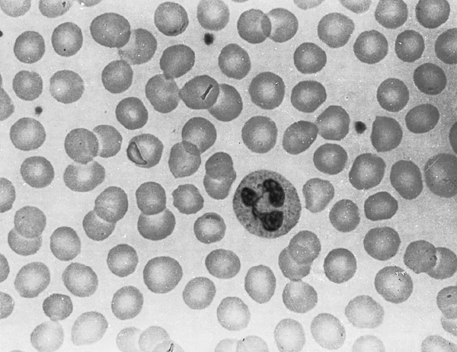
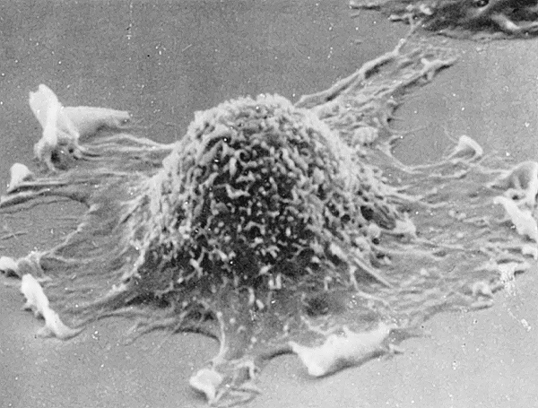
A polymorphonuclear leukocyte (surrounded by erythrocytes in a blood smear) with a trilobed nucleus and cytoplasmic granules.
A scanning electron micrograph of a macrophage with ruffled membranes and a surface covered with microvilli.

Slide 11
The cells of the immune system originate from the pluripotent hematopoietic stem cells the bone marrow
The myeloid progenitor is the precursor for granulocytes, macrophages, dendritic cells, and mast cells
Granulocytes have densely staining granules in the cytoplasm. Also called as polymorphonuclear leukocytes because of the oddly shaped nuclei.
Neutrophils, most numerous, phagocytic, and important component in innate immune response. First-line of defense
Eosinophils are important players in parasitic infections
Basophils is similar and complementary to mast cells
Macrophages are the mature form of monocytes. Monocytes that circulate in the blood differentiate into macrophages once they migrate to a tissue.
Dendritic cells are specialized to take up antigen, process it, and display it for recognition by T lymphocytes.
Mast cells differentiate in the tissues. Play a critical role in allergic responses and also, protect mucosal surfaces against pathogens.

Slide 12
The common lymphoid progenitor gives rise to lymphocytes (T and B lymphocytes) of the acquired immunity, and natural killer cells (NK cells) of the innate immunity.
T lymphocytes mature and differentiate in the thymus while B lymhocytes differentiate within the bone marrow
T and B lymphocytes have specific receptors (T cell receptor and B cell receptor) that help the body to mount an immune response against any foreign antigen.
NK cells lack antigen-specific receptors
T cells
secrete cytokines
help activate T cells
cause T cell proliferation
activate cytotoxic T cells
stimulate leukocyte production
stimulate B cells to mature
activate macrophages
secrete toxins that kill cells
secrete growth-inhibiting factors
secrete interferon
cellular immune response
B cells
differentiate into plasma cells
produce antibodies
humoral immune response

Slide 13
What is an Antigen and an Antibody ?
Antigen : Any substance when introduced into the body stimulates the generation of an antibody. Now the term, in a broader sense refers to any substance that can be recognized by the adaptive immune system. Also known as Immunogen. They can be
Bacteria, fungus, parasite
Viral particles
Other foreign material
Antibody: Also known as Immunoglobulin (Ig), it is a Y-shaped protein,
produced by the B cells that recognize and neutralize specific antigen.

Slide 14
Antigens vs Immunogens
An antigen is defined as any substance capable of stimulating the synthesis of antibodies.
This had a serious limitation in that the cell-mediated immunity was not included.
Hence was coined the term “immunogen”.
Immunogens are all substances(foreign body etc..) which can elicit an immune response.
Immunogens capable of eliciting allergic reactions or hypersensitvity are called “allergens”.

Slide 15
Types of antigens
Antigens may be:
A) Natural antigens : They are obtained from biological sources
Particulate antigens : bacteria, viruses, erthyrocytes, cells
Soluble antigens: bacterial toxins, proteins, glycoproteins, lipoproteins etc..
B) Synthetic antigens: They are artificially made: eg polymers of amino acid

Slide 16
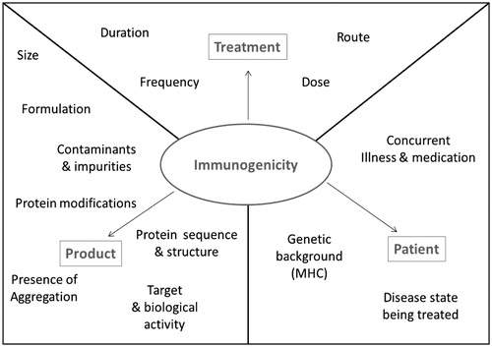
Factors determining Immunogenic Potency of a drug

Slide 17
Factors of the Product
Chemical Nature:
Proteins are the strongest immunogens
The immunogenic potential usually varies like:
protein > polysaccharide > lipid > nucleic acid
Nucleic acids are not antigenic in animals, but antibodies to DNA has been observed in patients with SLE (Systemic lupus erythematosus).
2. Complexity and heterogenecity:
A homopolymer polypeptide chain of any amino acid, even though big in size, fails to induce immune response due to lack of heterogeneity.
Addition of different amino acids at different sites of the same homopolymer makes it immunogenic.
Since the structural complexity of a protein is different at different levels of formation, the immunogenicity of a protein during its formation and after its formation are different.
Generally aromatic residues like tyrosine will contribute more towards immunogenecity.

Slide 18
3. Size:
Generally the size of the antigen molecule influences the immunogenicity. Substances with a molecular weight of about 100000 Daltons show best immunogenicity and substances less than 5000 to 10000 Daltons are poor immunogens.
For example, large molecules such as hemocyanin (6000.000 dt) and thyroglobulin (9669000 dt) show excellent immunogenicity. The proteins like insulin, histone etc. with low molecular weight fails to produce proper immunological response when exposed to immune system.
4. Foreignness
The very important and essential character required, for any substance to be immunogenic is its foreignness.
Since immune system is designed to react with foreign molecules, antigens from related species are less antigenic than that of unrelated species.
The phylogenetic distance between two species generates disparity between antigens, but there is same exception to contain molecules such as collagen, and cytochrome C, because they are highly conserved throughout evolution and therefore display very little immunogenicity across diverse species lines

Slide 19
Types of antigens and antigenecity
Chemical nature
Size
Compelxity
Antigen presentation
Foreignness
- Recognization of epitopes and stimulation of antibodies

Slide 20
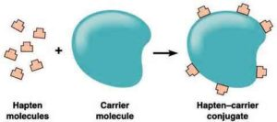
Haptens
Haptens are small molecules which by itself cannot stimulate antibody production, but can combine with an antibody once it is formed (haptein : to fasten)
The concept of haptens emerged from the work of Karl Landsteiner who also pioneered the use of synthetic haptens to study immunochemical phenomena.
Haptens are usually coupled to protein parts and are called Carriers.
2-4dinitrophenyl(DNP); m-aminobenjene sulfonate are common examples of haptens

Slide 21
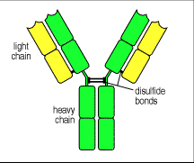
Structure of an Antibody
1. Immunoglobulin molecules consist of
2 heavy chain (green)
2 light chain (yellow)
joined by disulfide bonds.
2.Each chain has a Variable region (V-region)
and a Constant region (C-region)

Slide 22
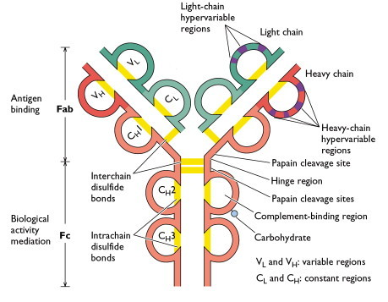
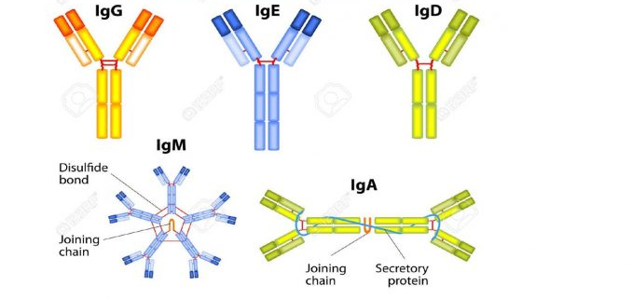

Slide 23
Antigen –Antibody reaction
The antigens and antibodies bind very specifically to each other. This interaction is referred to the antigen-antibody reaction.
This reaction form the basis for both humoral or adaptive immunity.
The specificity of these reactions has allowed the development of a variety of immunological assays –like detecting infectious disease agents etc.

Slide 24
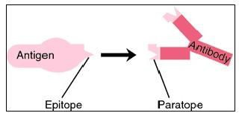
Molecular mechanisms of Antigen-Antibody
reaction
An antibody binds to an antigen through the complementarity of the shapes (just like a lock and a key ).
The part of the antigen which binds to the antibody is called the Epitope.
The part of the antibody that recognizes the Epitope is called the
Paratope.

Slide 25
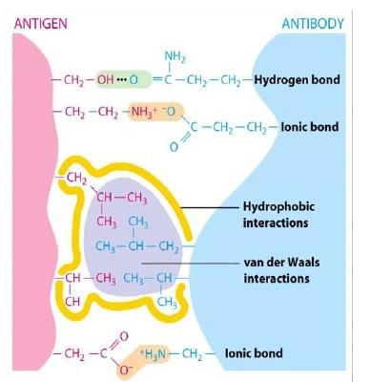
Physical Forces binding Antigen to Antibody
When an antigen and its corresponding antibody comes in proximity with each other, they bind through non-covalent bonding.
Non-covalent bonding in an antigen-antibody reaction may be:
Coulombic or electrostatic force
van der Waal’s force
Hydrophobic force
Hydrogen bonding
▪Non-covalent binding forces are relatively weak and operate over short distances, in general the antigen needs to be within 1Å of the antibody binding site.

Slide 26
Salient features of an antigen-antibody reaction
Binding site of Antigen-Antibody reaction (Epitope-Paratope)
Binding force of Antigen-Antibody reaction
Non-covalent forces
Specificity
Affinity Avidity
Cross reactivity

Slide 27
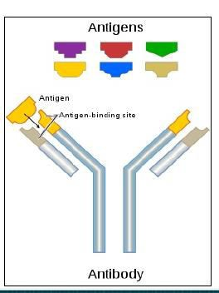
Specificity
Specificity
individual
refers
to the ability of an
antibody combining site to
react with determinant
only
one antigenic
For example: an antibody for a kidney antigen should bind to only the kidney antigen and not to any other antigen
(just like there is a unique key for an
unique lock)

Slide 28
Affinity
The strength of all non-covalent interactions between a singleparatope and a single epitope determines the affinity of binding.
A weak affinity would lead to a weak binding, will be short lived and easily disturbed.
A strong bonding, on the other hand would be an interaction of high affinity and would be hard to dissociate.

Slide 29
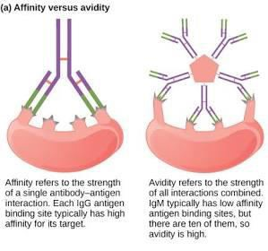
Avidity
Avidity is a measure of the overall strength of binding of an antigen with many antigenic determinant and multivalent antibodies.
(The total binding strength of a molecule with more than one binding site... Strength of all interactions combined)
A high avidity may compensate for a low affinity and is often a better measure of effectiveness in a biological situation
(For example, IgM has low affinity antigen binding sites than IgG, but IgM has 10 binding sites as compared to 2 in an IgG, thus it binds to an antigen more effectively)

Slide 30
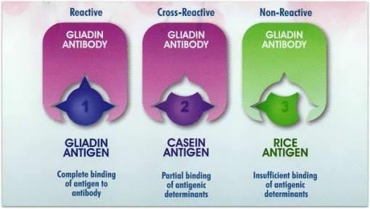
Crossreactivity
A cross-reaction is defined as the binding of an antibody to an antigen other than the immunogen it was specifically generated for.
Takes place if two different antigens are partially similar.
Sometimes viruses and bacteria have antigenic determinants similar to host component. These antigens then elicit antibodies which cross react with host cells, causing tissue damage.

Slide 31
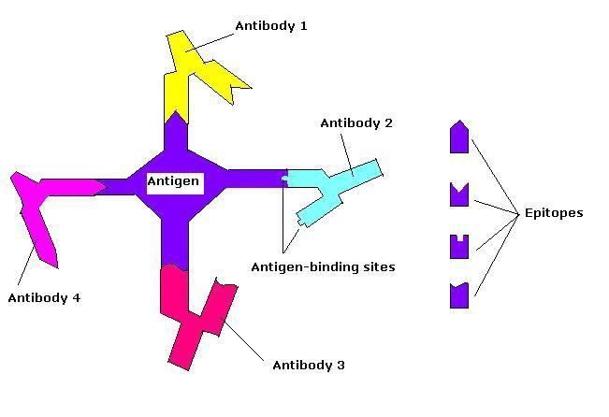
Polyclonal and monoclonal antibodies
Polyclonal antibodies (pAbs) are antibodies that are secreted by different B cell clones within the body. They are a collection of immunoglobulin molecules that react against a specific antigen, each identifying a different epitope.
▪Protein antigen usually will have many epitopes.
▪Each B cell clone (one set of B cells) will produce one set of antibody against one specific epitope.
▪Different clones of B cell will make different antibody pools.
▪The mixture of all is polyclonal antibodies against this one antigen.

Slide 32
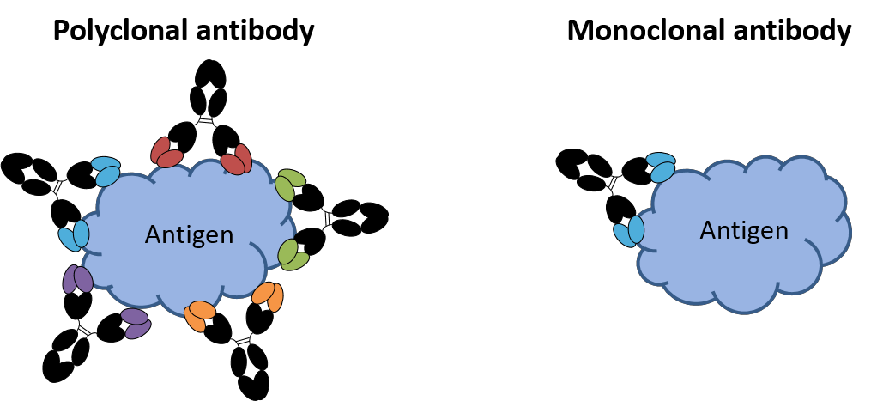
Monoclonal antibody
Monoclonal antibodies (mAb or moAb) are monospecific antibodies that are made by identical B cell clones. Monoclonal antibodies in bind to the same epitope.
It is possible to produce and purify that very specifically bind to the particular antigen and is one of the most promising commercial ventures. (UNIT III).

Slide 33
Antigen–Antibody diagnostics
reactions
as a tool for
▪The specificity and sensitivity of the antigen-antibody reaction has allowed the development of assays.
▪In diagnostics and other applications, this binding of antigen to antibody can be detected by:
➢some form of fluorescent tags (as in immunoflourescence and FACS)
➢by some enzyme which produces colour (as in ELISA)
➢by radioactive labelled isotopes (as in RIA) or
➢by measuring and monitoring the clumping or precipitation events (as in immunoelectrophoresis or agglutination assays).

Slide 34
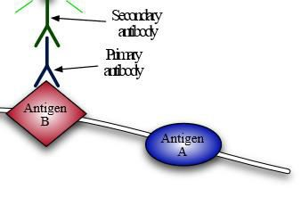
Primary and secondary antibodies in immunoassays
Primary those
antibodies are groups of
that
antibodies
directly
target
the protein (or antigen)
Secondary antibodies are those that target another (primary) antibody that, in turn, is bound to an antigen or protein

Slide 35
ELISA
Enzyme linked immunosorbent assay (ELISA) was originally descibed by Engvall and Perlmann in 1972.
Before the introduction of ELISA or alternately called EIA, the only option of conducting an immunoassay was Radio immunoassay (or RIA).
Because radioactivity poses a potential health threat, a safer alternative was sought. A suitable alternative to radioimmunoassay would substitute a nonradioactive signal in place of the radioactive signal.
The method is based on the conjugation of an enzyme (covalently to an antibody) which then produces some colour upon addition of the substrate .
The most commonly used enzymes are peroxidases, betagalctosidase, alkaline phosphatase etc.

Slide 36
Principle
The antigen that needs to be detected is bound to an antibody specific for the antigen.
An enzyme is covalently conjugated to the antibody , keeping its enzymatic and immunological properties active.
Upon addition of the enzymes substrate, a reaction takes place, converting the substrate into a coloured compound.
The coloured reaction is measured in a spectrophotometer.
Usually, in an ELISA assay, either the Ag or one of the Ab for the antigen is first bound to the inner walls of a plastic plate.
https://www.youtube.com/watch?v=JFXVPOym3fs

Slide 37
Different types of ELISA
1. Indirect ELISA: Useful to measure antibody levels in the body
The Antigen to be detected is adsorbed to the wells of a plate.
The serum/blood/urine in which the Ab level against the Ag is to be measured is added.
The Ab in the sample bind to the coated antigen
Excess Ab is washed away.
A secondary Ab(anti-IgG) linked with an enzyme is now added
This secondary Ab binds to the bound antibody
Substrate is added generating the colour.

Slide 38
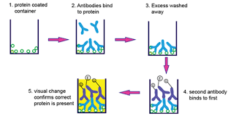
Schematic representation of an indirect ELISA

Slide 39
2. Sandwich ELISA : Useful to detect/measure antigens or foreign particles in the body
The specific antibody against the antigen to be detected is adsorbed to the wells of a plate. (often called the coating Ab).
The test sample of Ag is to be measured is added.
The Ag molecules in the sample bind to the precoated Ab.
A second Ab linked with an enzyme is now added which can bind to the Ag bound to the capture Ab ( This second Ab is called Detection Ab).
Substrate is added generating the colour
Sandwich ELISA is so named because the antigen to be detected in “sandwiched” between two Abs

Slide 40
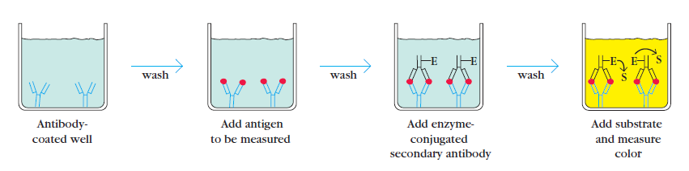
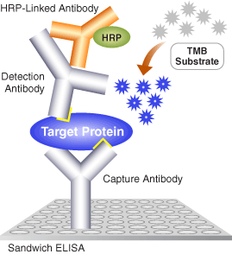
Schematic representation of a Sandwich ELISA
https://www.youtube.com/watch?v=MzrJ35aQPMo

Slide 41
3. Competitive ELISA : A variation also used to detect Ags
The specific is first incubated in solution with a test sample containing antigens (say blood)
This antigen-antibody mixture is then added to the antigen precoated microtitre plate
A secondary Ab enzyme linked is now added as in other methods and substrate added to develop colour.
The more antigen present in the sample in the first place, the less free Ab will be available to bind to the antigen-coated well – This will lead to Less colour reaction.

Slide 42
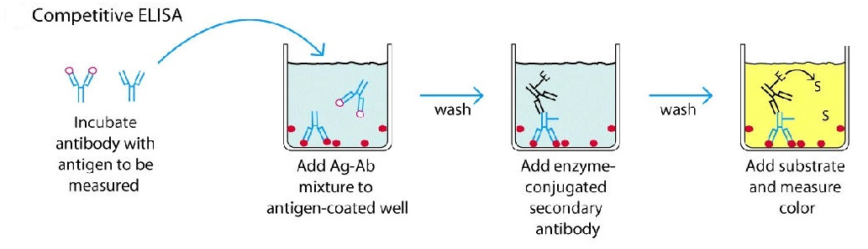
Schematic representation of a Competitive ELISA

Slide 43
Advantages and applications of ELISA
ELISA is a very specific and sensitive technique.
Simpler, non-toxic and much cheaper than radioassay.
It is widely used to detect antigens or antibodies in the samples in clinical microbiology, food technology, toxicology etc.
It is extremely useful in determining the concentrations of serum antibody during infection – like in the test of HIV or West Nile Virus.
Food industry has also taken advantage of this field as it is used to detect the allergens in the foods like milk, peanut, eggs, almonds and walnuts and almost all the foods which are rich with proteins.
Certain drugs can be analyzed by using the method of ELISA in the field of toxicology.

Slide 44
Agglutination reaction
Agglutination is the clumping of particles. The word agglutination comes from the word agglutinare (glueing to, in Latin).
The interaction of particulate antigens (cells that carry antigens) with antibodies leads to agglutination reactions.
Cross linking of cells/large particles by antibodies directed against surface antigens leads to agglutination.
Very similar to precipitation and Like precipitation reaction, this is also highly specific depending upon specific antibody and antigen pair.
Antibodies that produce this reaction are called agglutinins

Slide 45
Hemagglutination
Is a specific form of agglutination that involves red blood cells (RBCs) (hema/hemo: blood).
Can be direct or passive
Commonly used for blood typing/blood grouping.
Blood group matching is crucial for transfusion (mismatch can lead to Acute hemolytic reaction and even death ) and pregnancy (one major cause of fetus death; erythroblastosis foetalis)

Slide 46
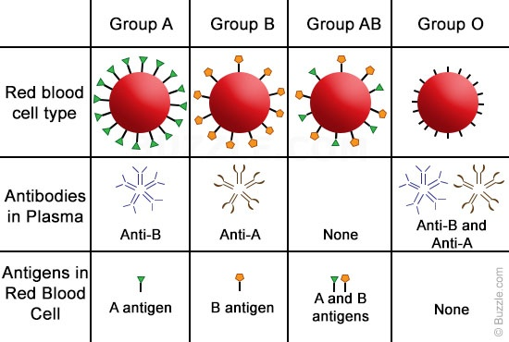
Blood Groups
Blood is typed, or classified, according to the presence or absence of certain markers (antigens) found on red blood cells and in the plasma that allow your body to recognize blood as its own.
If another blood type is introduced, your immune system recognizes it as foreign and attacks it, resulting often in lysis (destruction of the RBC)
https://www.youtube.com/watch?v=-jKzLLHjRfs

Slide 47
